Slide 1

ECE313 Final Project 3B, Fall 2021
Switching Bilateral Filter for With a Texture/Noise Detector for Universal Noise Removal
Francis Chambers & David Hardy
Date of Submission: December 23rd , 2021

Slide 2
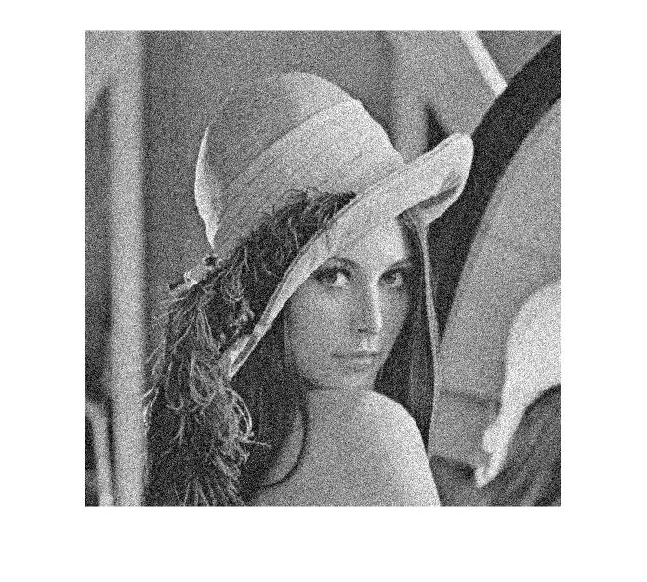
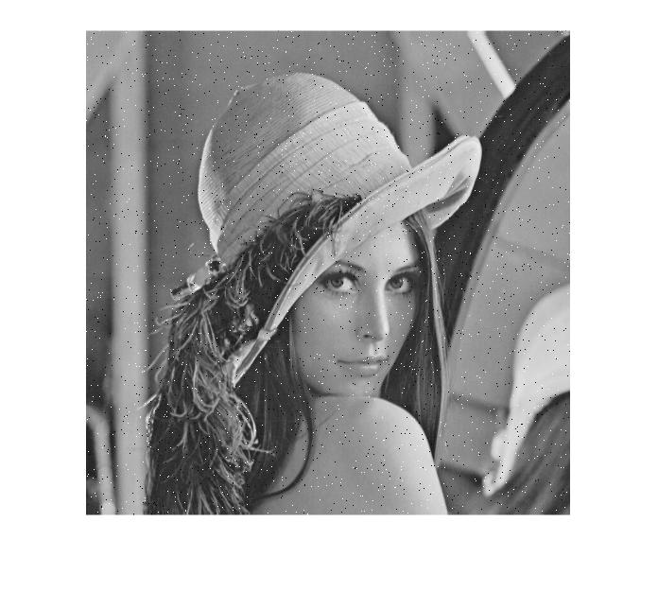
Problem Formulation
A key problem in image processing is removing image noise.
Image noise is the degradation of an image signal which results in the undesired variation of pixel brightness and colour.
Gaussian noise is generated from the limitations of camera sensors or low-light conditions.
Impulse noise arises from transmission errors or hardware defects.
Gaussian Noise
Impulse Noise

Slide 3
Existing Solutions
Many image filtering techniques exist such as median filters and smoothing filters.
Many of these noise filters can only filter one type of noise and may distort other pixels.
For example, median filters do not filter Gaussian noise and tend to break image edges. Smoothing filters can filter Gaussian noise, but they do not filter impulse noise very well, and they tend to blur edges.
Mixed noise filters for Gaussian and impulse noise can have quite complex algorithms.

Slide 4
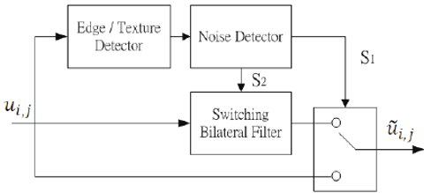
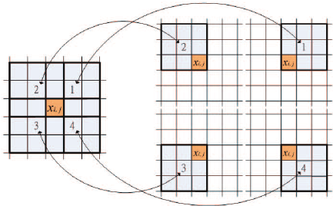
Proposed Solution
The research paper proposes a switching bilateral filter (SBF) which can filter both Gaussian and impulse noise with less complexity and a greater signal to noise ratio than many other mixed filters.
The SBF has two stages: (1) The type of noise is detected, and (2) the noise is filtered accordingly.
The step-by-step algorithm is as follows:
Obtain window and sub windows around centre pixel:
function [Omega0, Omega1, Omega2, Omega3, Omega4] = getWindowPoints(I,i,j,N)
Omega0 = zeros(2*N+1, 2*N+1); % initialize
for s=-N:N
for t=-N:N
Omega0(s+N+1,t+N+1) = I(i+s,j+t);
end
end
c = N+1;
e = 2*N+1;
Omega1 = Omega0(1:c, c:e);
Omega2 = Omega0(1:c, 1:c);
Omega3 = Omega0(c:e, 1:c);
Omega4 = Omega0(c:e, c:e);
end

Slide 5
Proposed Solution (Cont'd)
function [SQMV,SQMD_B,SQMD_C] = medianVector(A,B,C,D)
m1 = median(A(:));
m2 = median(B(:));
m3 = median(C(:));
m4 = median(D(:));
M = [m1, m2, m3, m4];
SQMV = sort(M);
SQMD_B = SQMV(4) - SQMV(1);
SQMD_C = SQMV(3) - SQMV(2);
The step-by-step algorithm goes as follows:
Determine the median vector (SQMV) from the four sub-windows.
Get the reference median from SQMV.
function [SQMR] = referenceMedian(SQMV,SQMD_B,SQMD_C,p, m1, m2, m3, m4, i, j, I, N)
dav = 0;
if (SQMD_C <= p) %no edge/weak edge
SQMR = (SQMV(2) + SQMV(3))/2;
else %strong edge
if(m1 == SQMV(1) && m2 == SQMV(2) && m3 == SQMV(3) && m4 == SQMV(4)) % horizontal edge
for n=-N:N
if(n ~= 0)
dav = dav + I(i, j+n);
end
end
elseif(m2 == SQMV(1) && m3 == SQMV(2) && m1 == SQMV(3) && m4 == SQMV(4)) % vertical edge
for n=-N:N
if(n ~= 0)
dav = dav + I(i+n, j);
end
end
else %diagonal edge%
dav = dav + I(i-1, j+1) + I(i-1, j-1) + I(i+1, j-1) + I(i+1, j+1);
end
dav = dav/4;
if(dav >= SQMV(3) && dav <= SQMV(4))
SQMR = SQMV(3);
else
SQMR = SQMV(2);
end
end
end

Slide 6
Proposed Solution (Cont'd)
function [S1,S2] = noiseDetector(x,SQMR,Tk1,Tk2)
S1 = 0;
S2 = 0;
if abs(x-SQMR) >= Tk1
S1 = 1;
S2 = 1;
elseif abs(x-SQMR) >= Tk2
S1 = 1;
S2 = 0;
end
end
The step-by-step algorithm goes as follows:
Noise detector: Determine whether the difference from the reference median and the pixel value constitutes noise.
Switching Bilateral Filter: Non-linear filter that replaces the intensity of each pixel with weighted average of nearby pixels using two Gaussian kernels.
function [value] = WG(i,j,s,t)
sigma_s = 1; % spatial variance chosen in research paper
num = (i-s)^2 + (j-t)^2;
den = 2*(sigma_s)^2;
value = exp(-num/den);
end
function [value] = WSR(x,Ic)
sigma_r = 40;
num = (Ic-x)^2;
den = 2*(sigma_r)^2;
value = exp(-num/den);
end
function [u] = SBF(I,i,j,N,Ic)
num = 0;
den = 0;
for s=-N:N
for t=-N:N
num = num + WG(i,j,i+s,j+t)*WSR(double(I(i+s,j+t)),double(Ic))*double(I(i+s,j+t));
den = den + WG(i,j,i+s,j+t)*WSR(double(I(i+s,j+t)),double(Ic));
end
end
u = num/den;
end

Slide 7
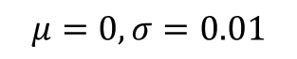
Experimental Results
$$μ=0,σ=0.01$$
The first figure (from the top) shows how the filtered image looks compared to the original image. The SBF filter has removed the impulse noise very well. A noticeable amount of Gaussian noise remains, but it still performed well in that regard.
The second figure compares the SBF filter with MATLAB’s built-in median filter medfilt2(). As seen, they both remove the impulse noise.
The third figure magnifies figure 2. As seen, the SBF filter smooths out the pixels better and hence applies filtering to Gaussian noise, whereas the median filter produces a slightly grainier result.

Slide 8
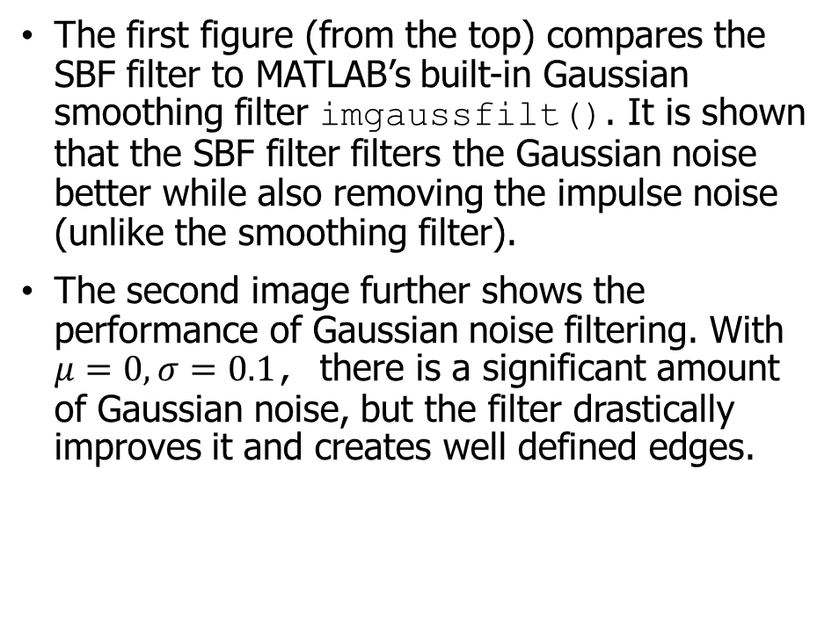
Experimental Results
The first figure (from the top) compares the SBF filter to MATLAB’s built-in Gaussian smoothing filter imgaussfilt(). It is shown that the SBF filter filters the Gaussian noise better while also removing the impulse noise (unlike the smoothing filter).
The second image further shows the performance of Gaussian noise filtering. With $μ=0, σ=0.1$, there is a significant amount of Gaussian noise, but the filter drastically improves it and creates well defined edges.

Slide 9
Conclusions
The SBF filter performed very well with filtering impulse noise.
Gaussian noise was filtered to a lesser effect but is still performed better than a common Gaussian smoothing filter.
The bilateral filter functions correctly as overall noise is reduced while maintaining edges and textures.

Slide 10
References
Lin, Chih-Hsing & Tsai, Jia-Shiuan & Chiu, Te-Ching. (2010). Switching Bilateral Filter With a Texture/Noise Detector for Universal Noise Removal. Image Processing, IEEE Transactions on. 19. 2307 - 2320. 10.1109/TIP.2010.2047906.

